Slide 1
Java & JEE Training
Day 13 – Exception Handling (Contd.)
MindsMapped Consulting

Slide 2
Review of Exception handling concepts from last session…
What is an exception? What is an error?
Throwable class – parent of Exception and Error
Types of Exception: Checked and Unchecked Exceptions

Slide 3
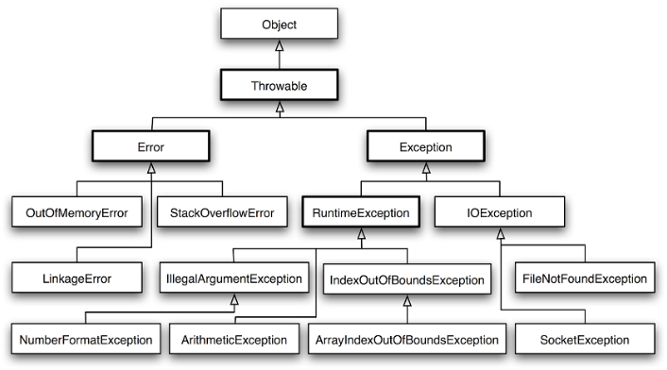
Checked vs Unchecked Exceptions – Hierarchy review
Checked Exceptions = Subclass of Exception
Unchecked Exceptions = Subclass of RuntimeException

Slide 4
Agenda
throw and throws keywords
Exception propagation – the cases of Checked and Unchecked Exceptions
Defining your own custom Exception

Slide 5
Throwing exception… “throw” keyword
public class TestThrow1{
static void validate(int age){
if(age<18)
throw new ArithmeticException("not valid");
else
System.out.println("welcome to vote");
}
public static void main(String args[]){
validate(13);
System.out.println("rest of the code...");
}
}

Slide 6
Exception propagation example.. Unchecked exceptions are propagated through the method call stack
class TestExceptionPropagation1{
void m(){
int data=50/0;
}
void n(){
m();
}
void p(){
try{
n();
}catch(Exception e){System.out.println("exception handled");}
}
public static void main(String args[]){
TestExceptionPropagation1 obj=new TestExceptionPropagation1();
obj.p();
System.out.println("normal flow...");
}
}

Slide 7
Program which describes that checked exceptions are not propagated
class TestExceptionPropagation2{
void m(){
throw new java.io.IOException("device error");//checked exception
}
void n(){
m();
}
void p(){
try{
n();
}catch(Exception e){System.out.println("exception handeled");}
}
public static void main(String args[]){
TestExceptionPropagation2 obj=new TestExceptionPropagation2();
obj.p();
System.out.println("normal flow");
}
}

Slide 8
Java throws keyword
The Java throws keyword is used to declare an exception. It gives an information to the programmer that there may occur an exception so it is better for the programmer to provide the exception handling code so that normal flow can be maintained.
  return_type method_name() throws exception_class_name{
  //method code
  }
Only checked exceptions should be declared, because
unchecked Exception: under your control so correct your code.
error: beyond your control e.g. you are unable to do anything if there occurs VirtualMachineError or StackOverflowError.

Slide 9
Java throws example
import java.io.IOException;
class Testthrows1{
void m()throws IOException{
throw new IOException("device error");//checked exception
}
void n()throws IOException{
m();
}
void p(){
try{
n();
}catch(Exception e){System.out.println("exception handled");}
}
public static void main(String args[]){
Testthrows1 obj=new Testthrows1();
obj.p();
System.out.println("normal flow...");
}
}

Slide 10
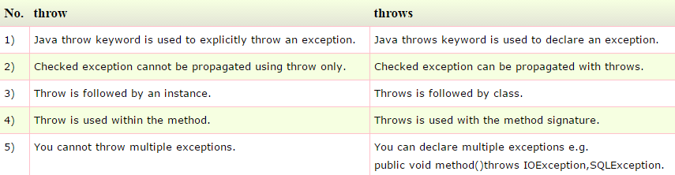
Difference between throw and throws in Java

Slide 11
Difference between throw and throws in Java
void m(){
throw new ArithmeticException("sorry");
}
void m()throws ArithmeticException{
//method code
}
void m()throws ArithmeticException{
throw new ArithmeticException("sorry");
}

Slide 12
Unchecked Exceptions? Why?
http://docs.oracle.com/javase/tutorial/essential/exceptions/runtime.html
Please read the article and let’s discuss this in next class.

Slide 13
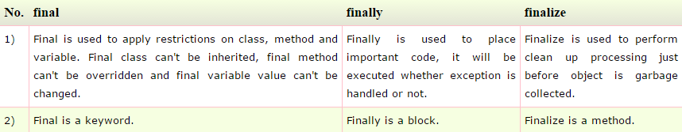
Difference between final, finally and finalize

Slide 14
What is the output?
public class Test
{
public static void aMethod() throws Exception
{
try /* Line 5 */
{
throw new Exception(); /* Line 7 */
}
finally /* Line 9 */
{
System.out.print("finally "); /* Line 11 */
}
}
public static void main(String args[])
{
try
{
aMethod();
}
catch (Exception e) /* Line 20 */
{
System.out.print("exception ");
}
System.out.print("finished"); /* Line 24 */
}
}

Slide 15
What is the output?
public class X
{
public static void main(String [] args)
{
try
{
badMethod();
System.out.print("A");
}
catch (Exception ex)
{
System.out.print("B");
}
finally
{
System.out.print("C");
}
System.out.print("D");
}
public static void badMethod() {}
}

Slide 16
What is the output?
public class X
{
public static void main(String [] args)
{
try
{
badMethod(); /* Line 7 */
System.out.print("A");
}
catch (Exception ex) /* Line 10 */
{
System.out.print("B"); /* Line 12 */
}
finally /* Line 14 */
{
System.out.print("C"); /* Line 16 */
}
System.out.print("D"); /* Line 18 */
}
public static void badMethod()
{
throw new RuntimeException();
}
}

Slide 17
What is the output?
public class MyProgram
{
public static void main(String args[])
{
try
{
System.out.print("Hello world ");
}
finally
{
System.out.println("Finally executing ");
}
}
}

Slide 18
What is the output?
class Exc0 extends Exception { }
class Exc1 extends Exc0 { } /* Line 2 */
public class Test
{
public static void main(String args[])
{
try
{
throw new Exc1(); /* Line 9 */
}
catch (Exc0 e0) /* Line 11 */
{
System.out.println("Ex0 caught");
}
catch (Exception e)
{
System.out.println("exception caught");
}
}
}

